Slide 1


Slide 2
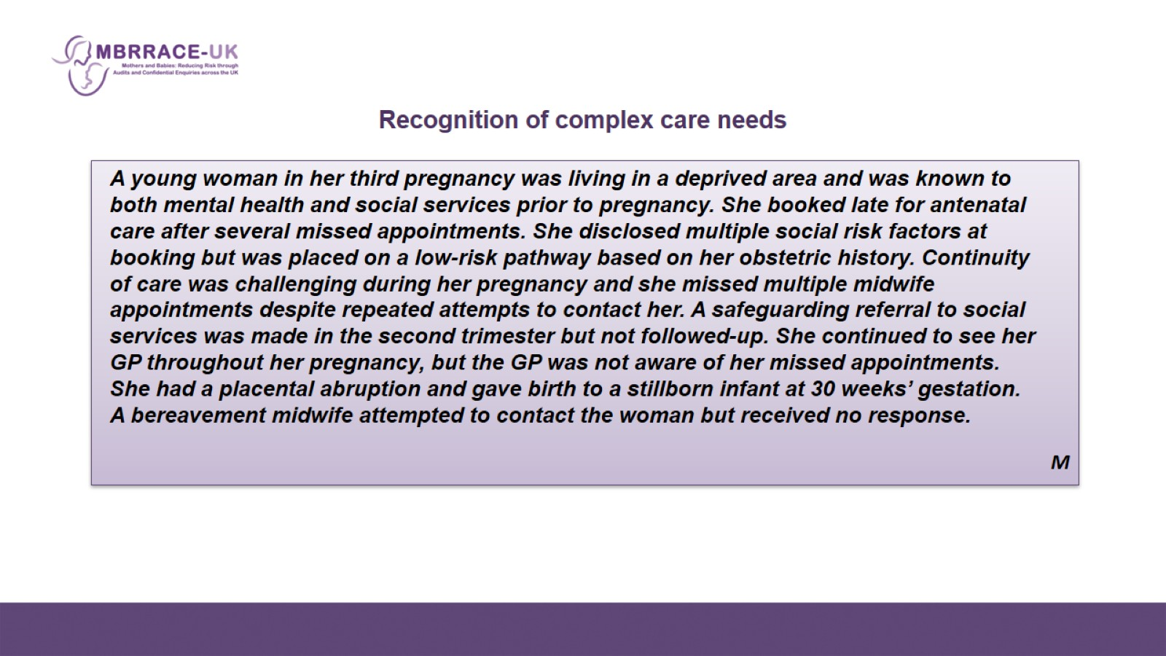
Recognition of complex care needs

Slide 3
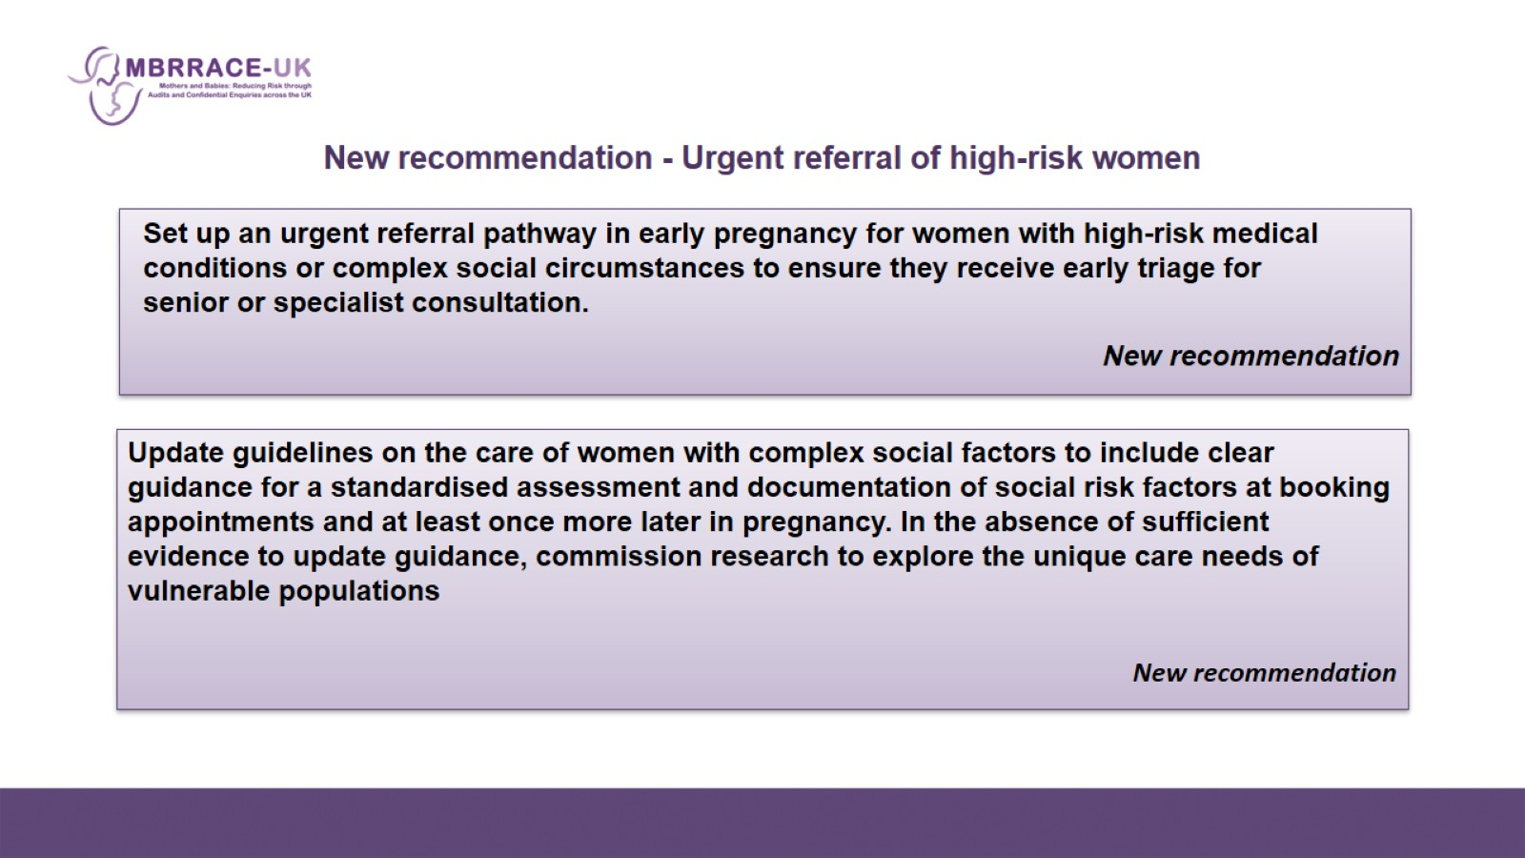
    New recommendation - Urgent referral of high-risk women

Slide 4
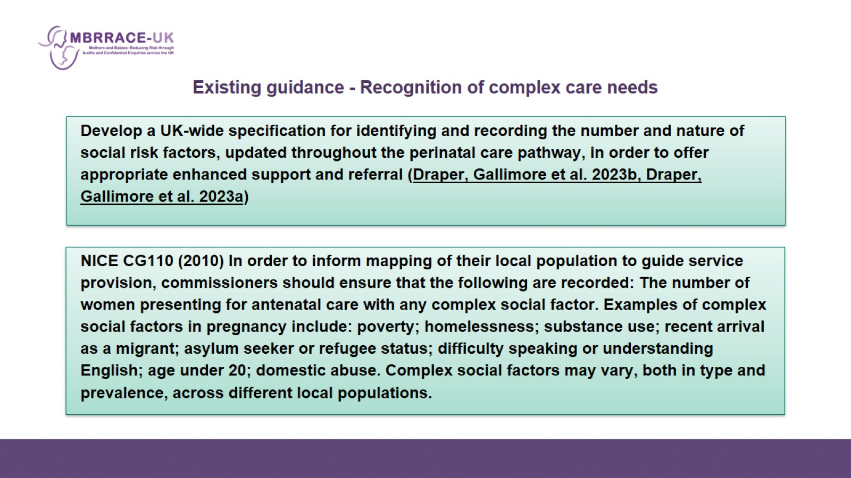
Existing guidance - Recognition of complex care needs

Slide 5
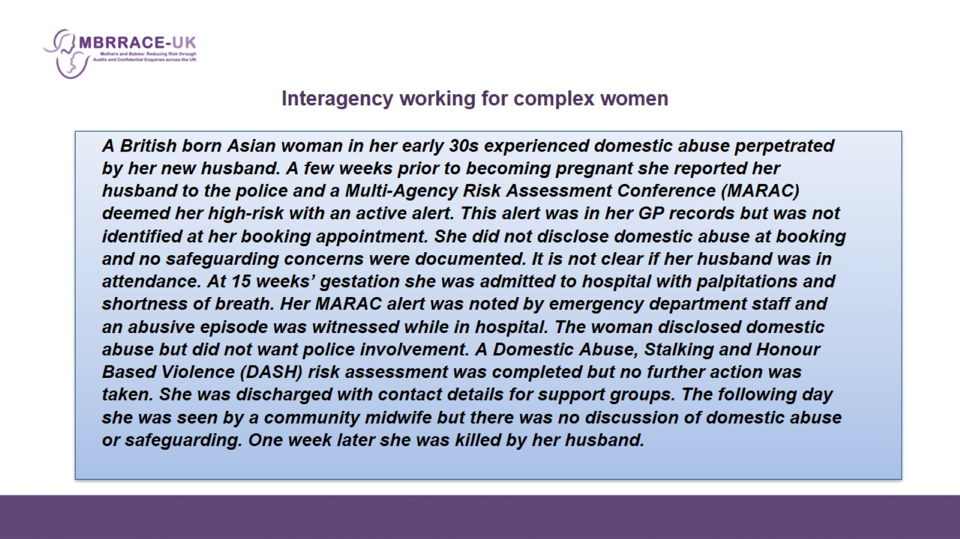

Slide 6
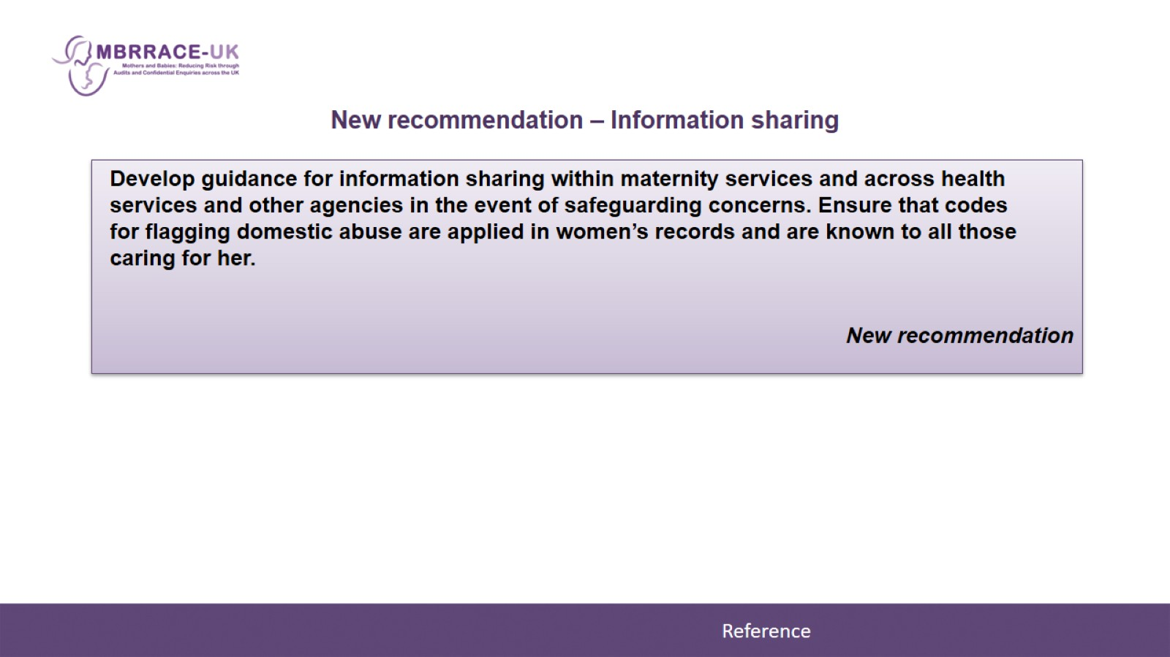
New recommendation – Information sharing

Slide 7
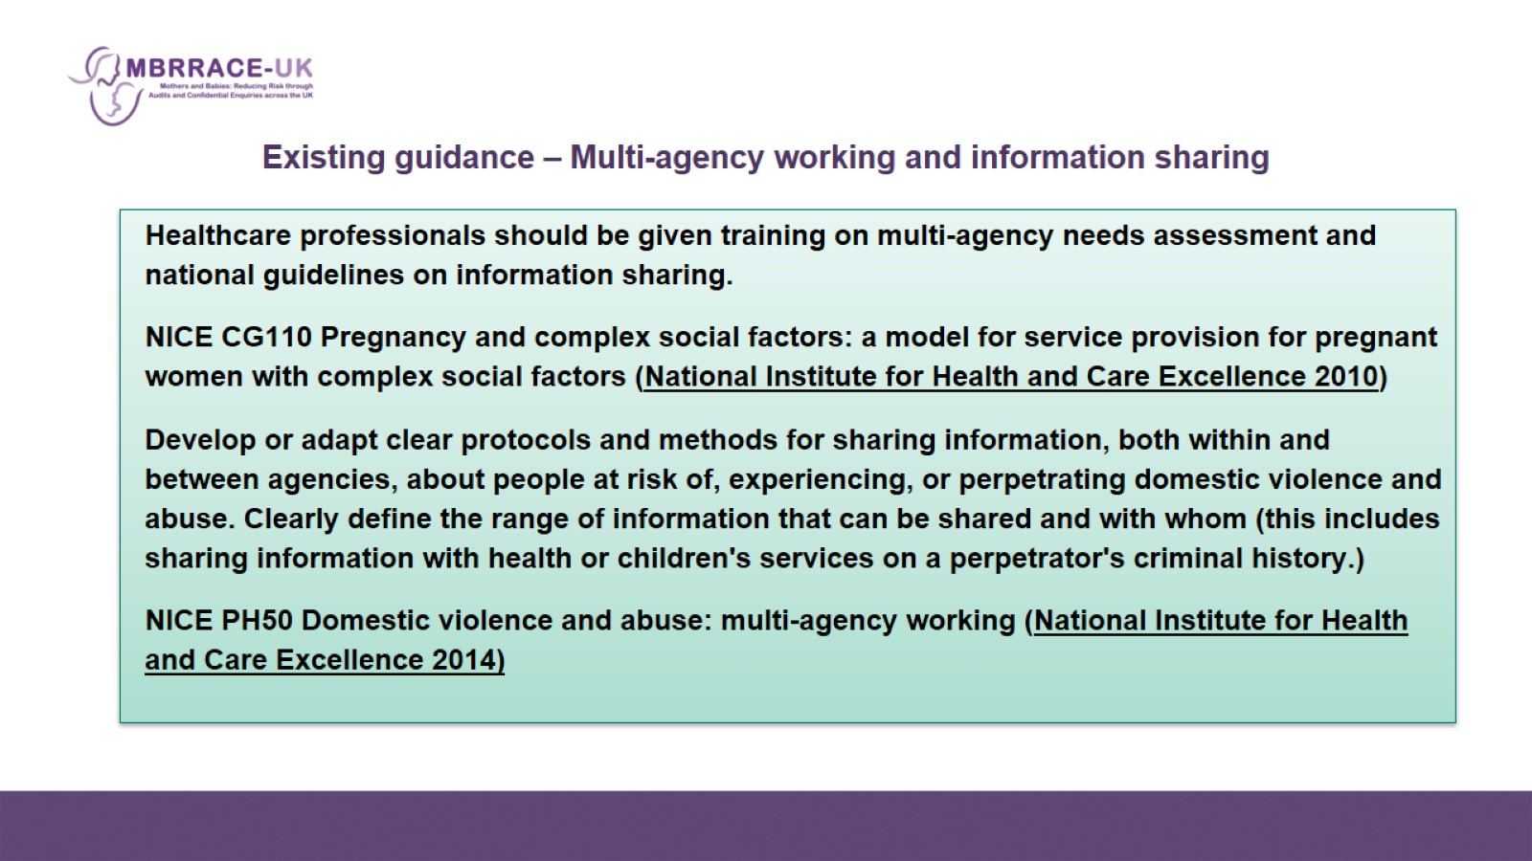
Existing guidance – Multi-agency working and information sharing

Slide 8
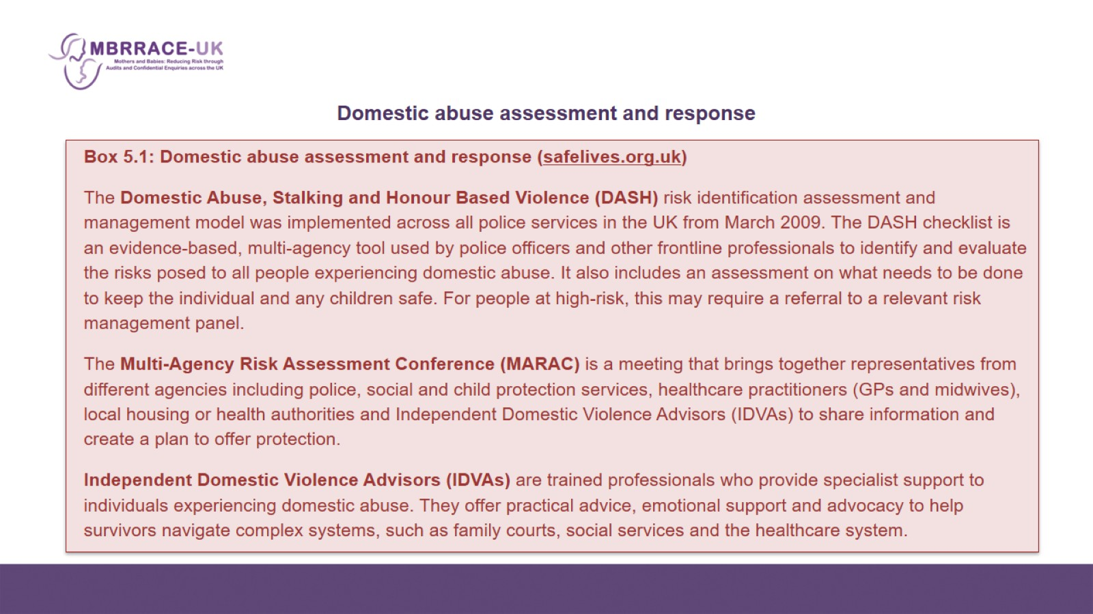
    Domestic abuse assessment and response

Slide 9
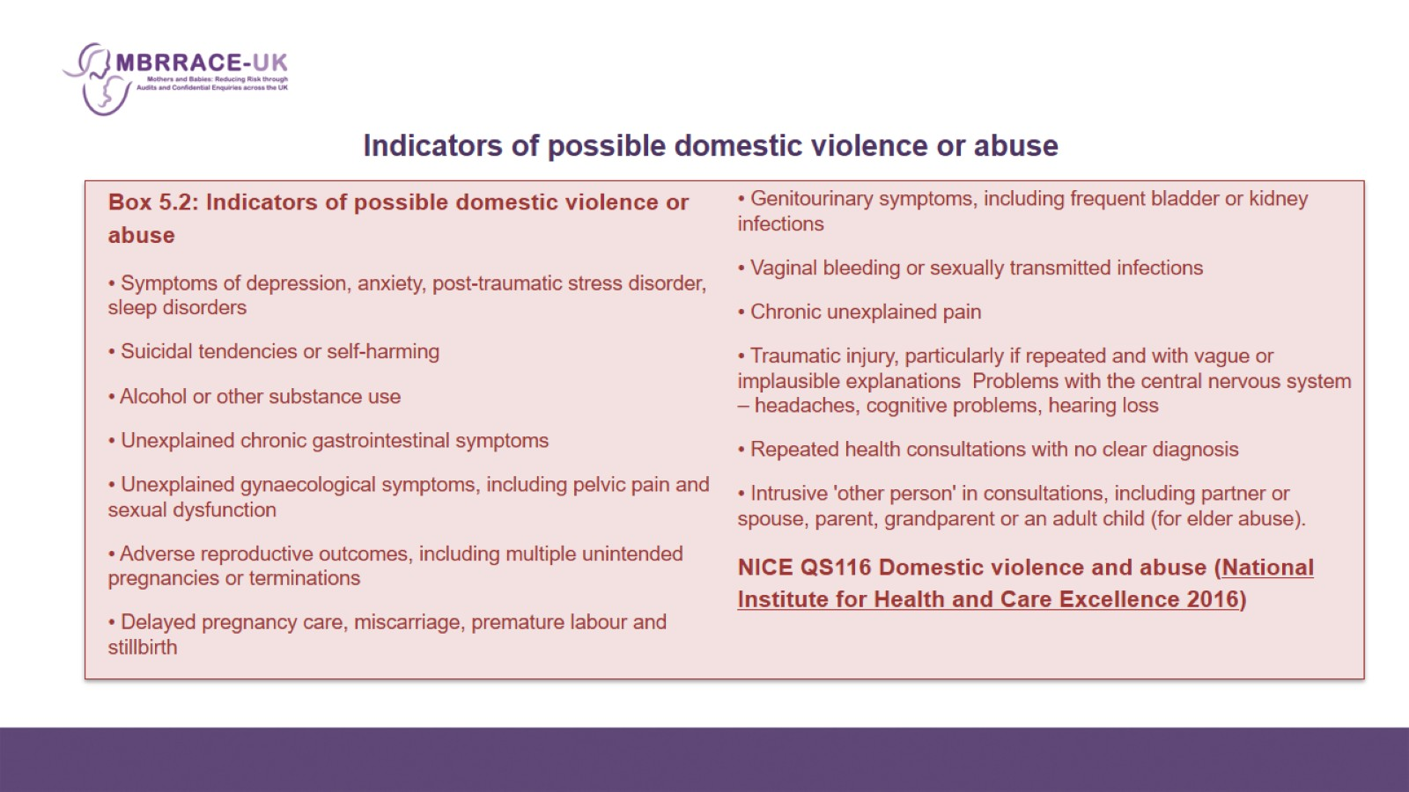
Indicators of possible domestic violence or abuse

Slide 10
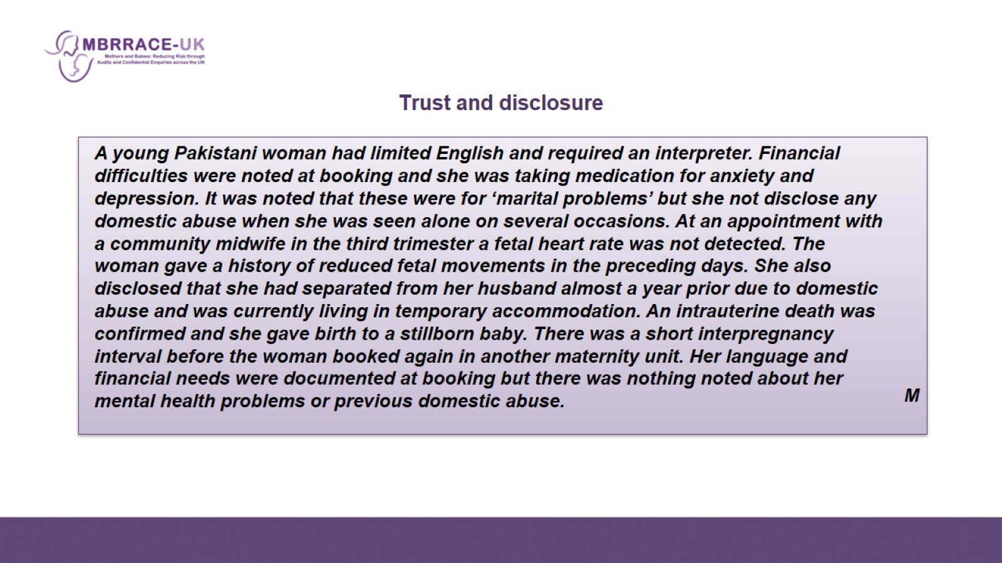
Trust and disclosure

Slide 11
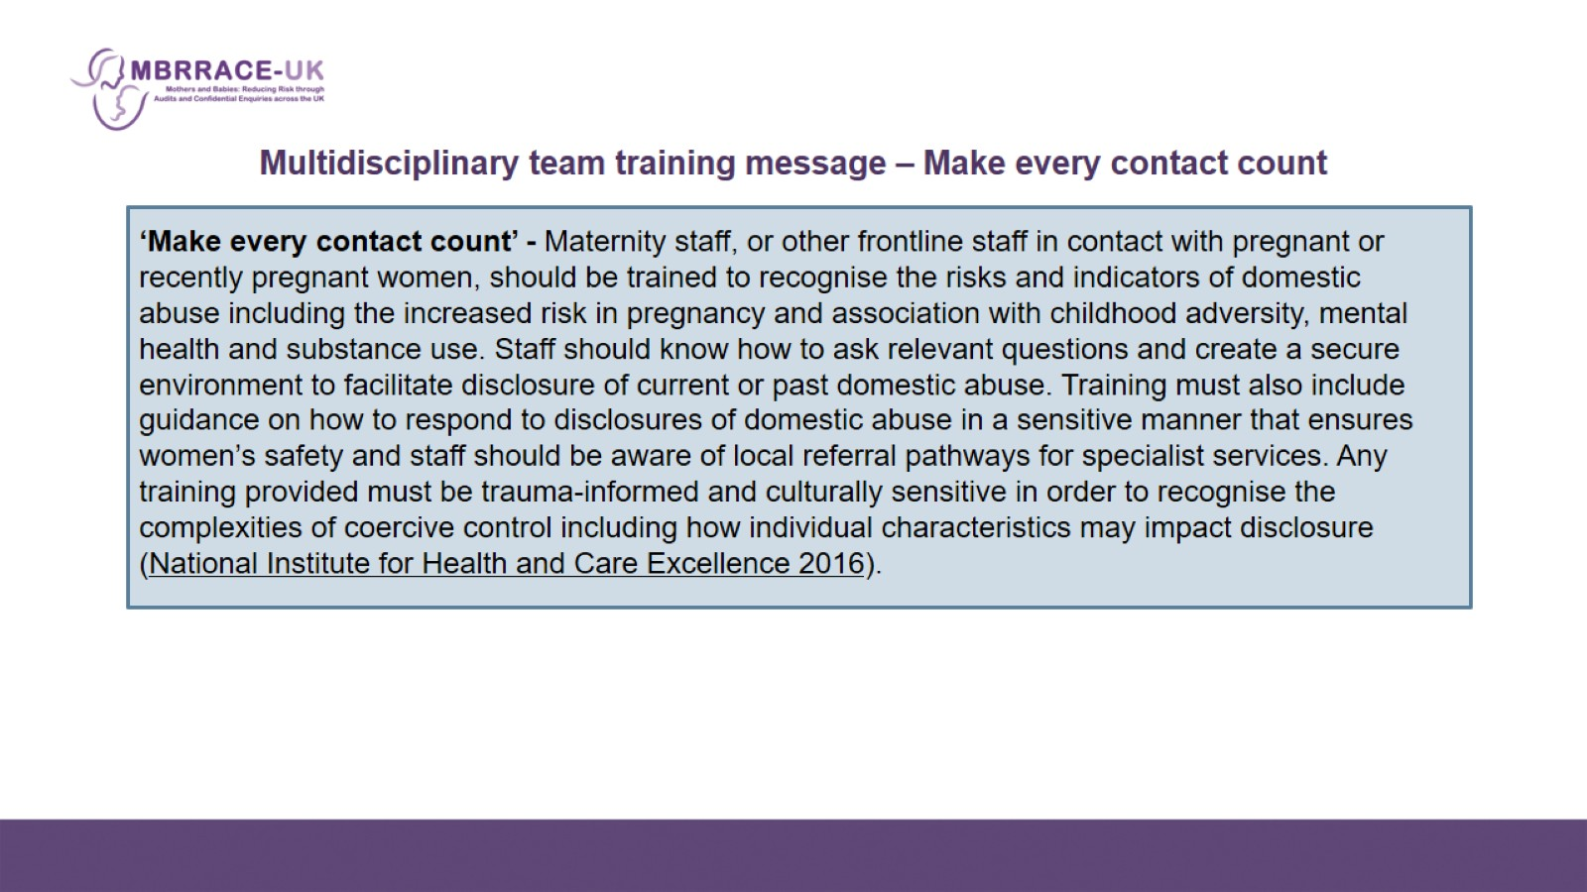
Multidisciplinary team training message – Make every contact count

Slide 12
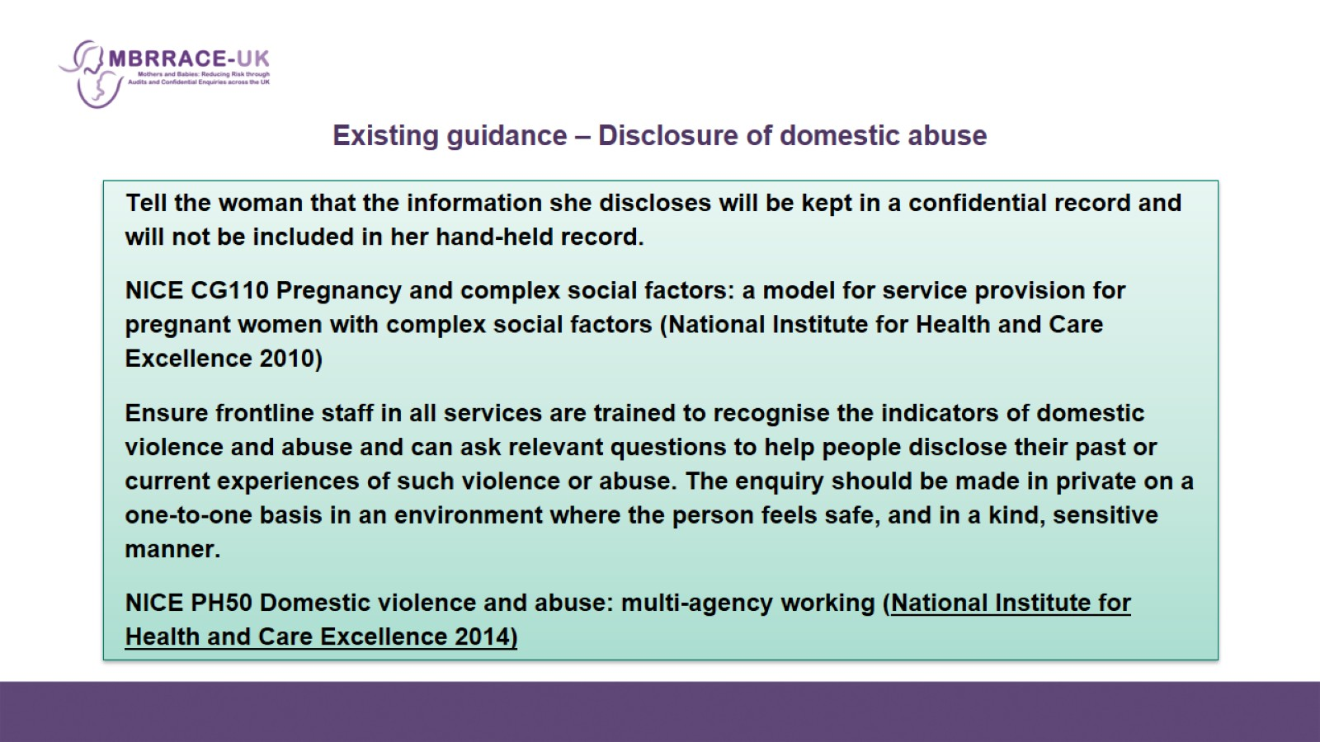
Existing guidance – Disclosure of domestic abuse

Slide 13
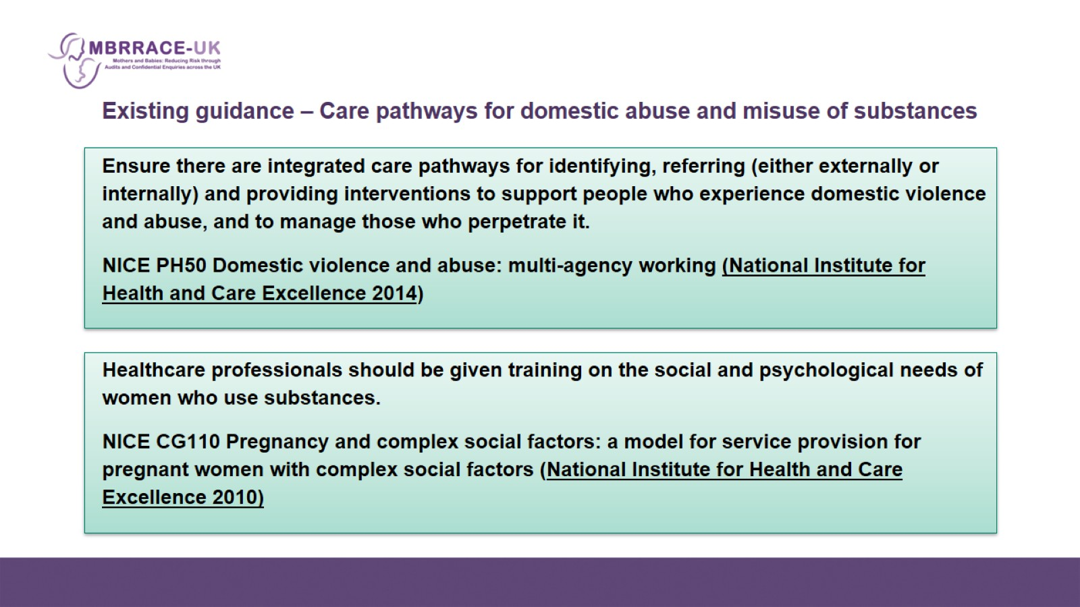
Existing guidance – Care pathways for domestic abuse and misuse of substances

Slide 14
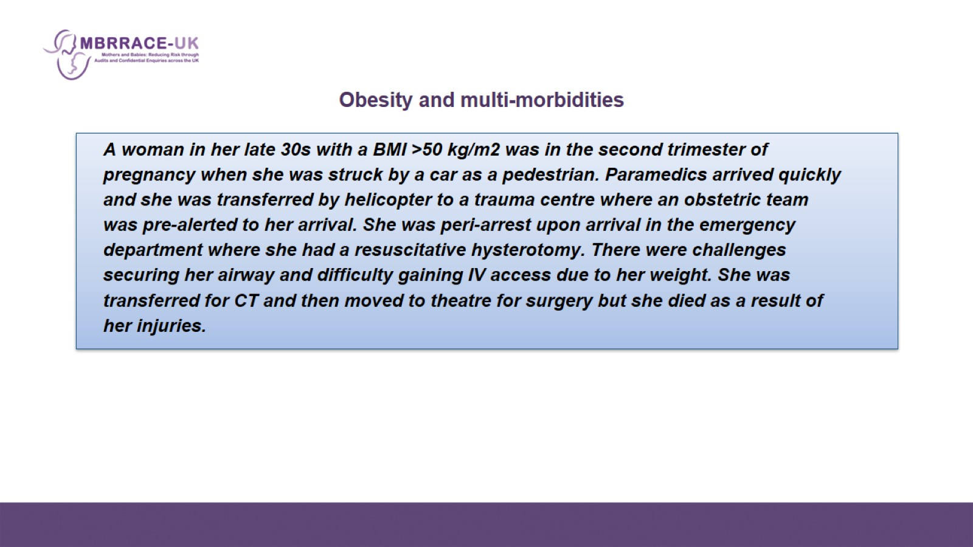

Slide 15
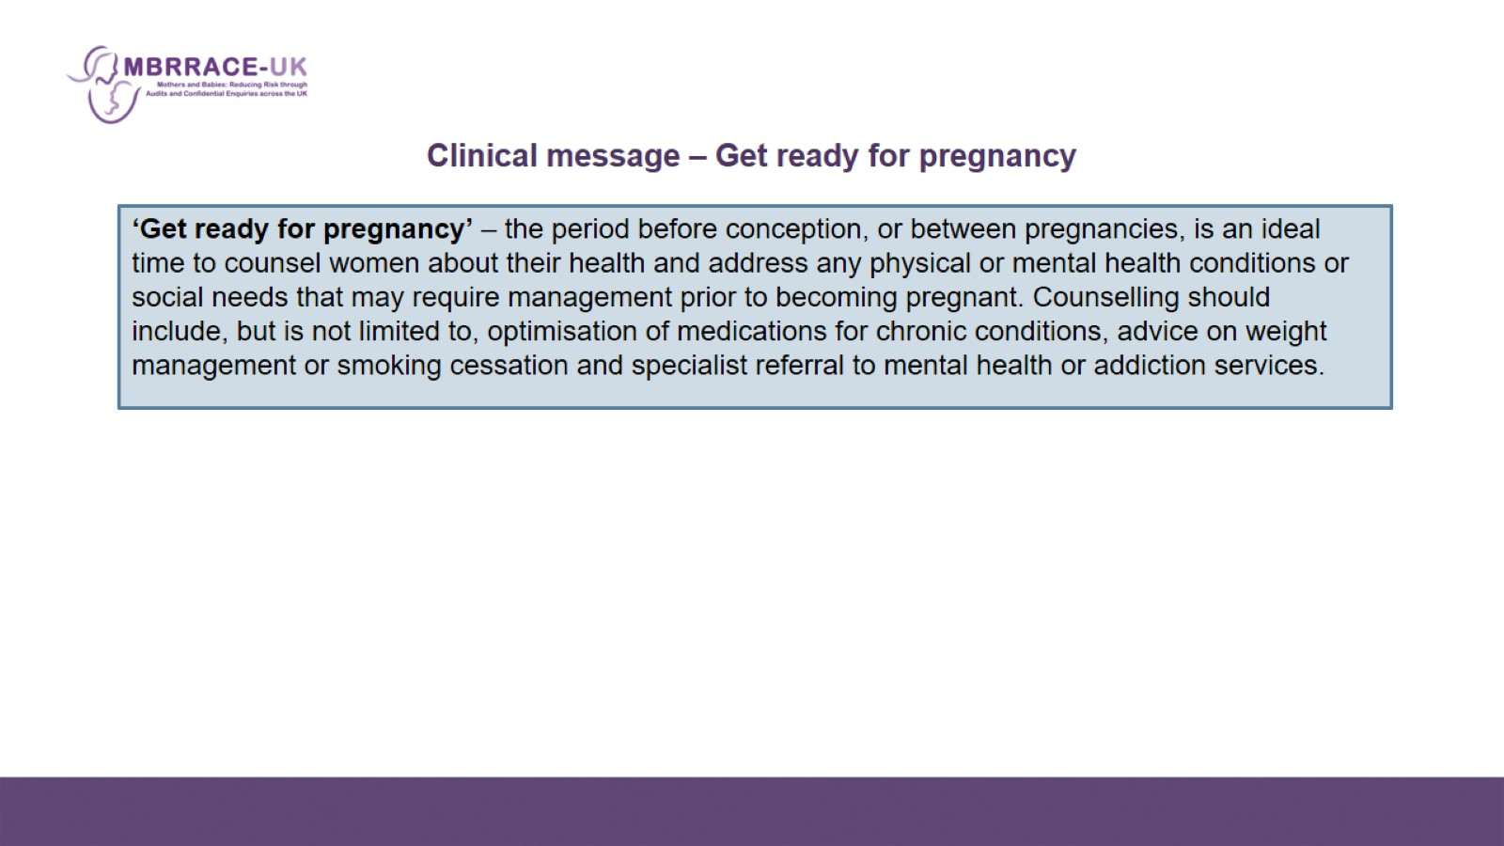
    Clinical message – Get ready for pregnancy

Slide 16
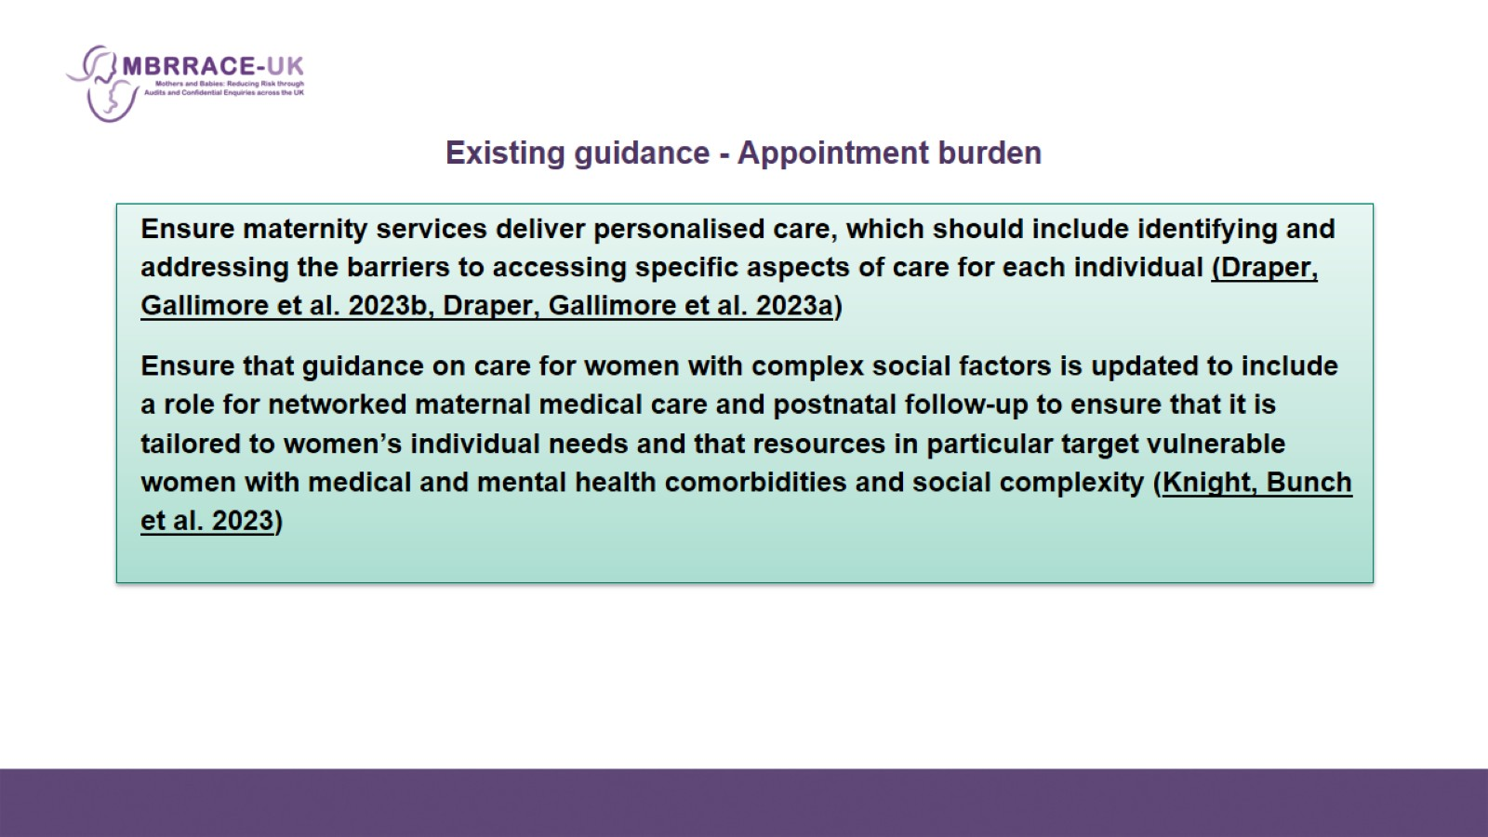
Existing guidance - Appointment burden

Slide 17
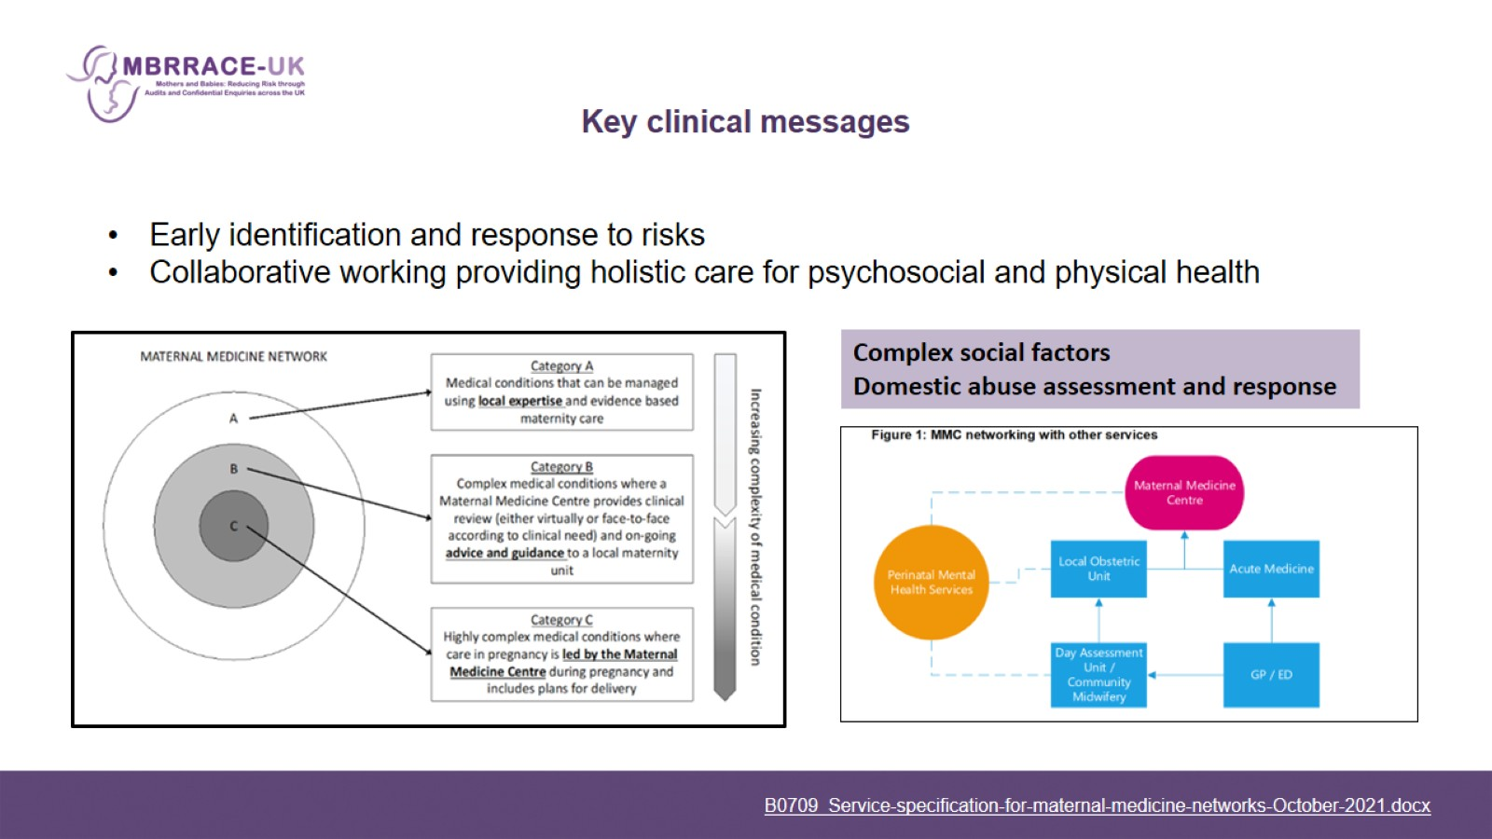
Key clinical messages

